Slide 1
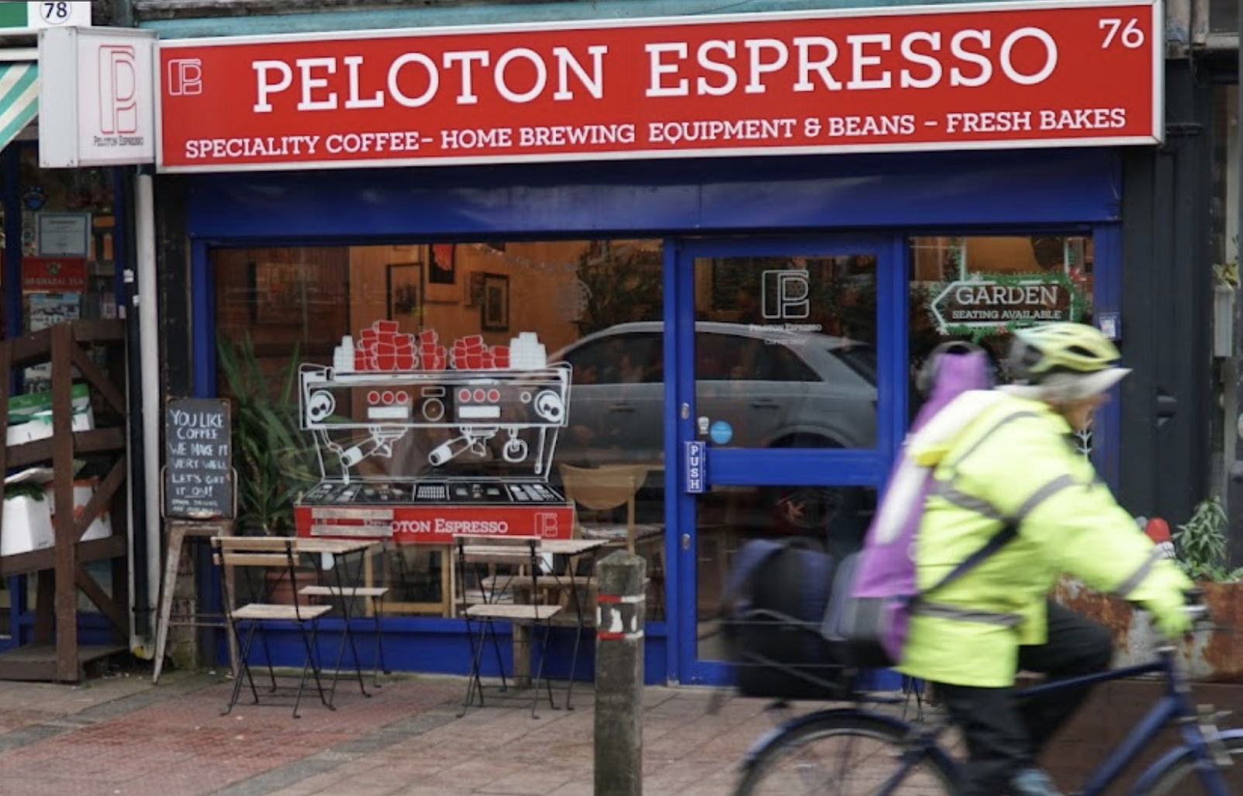
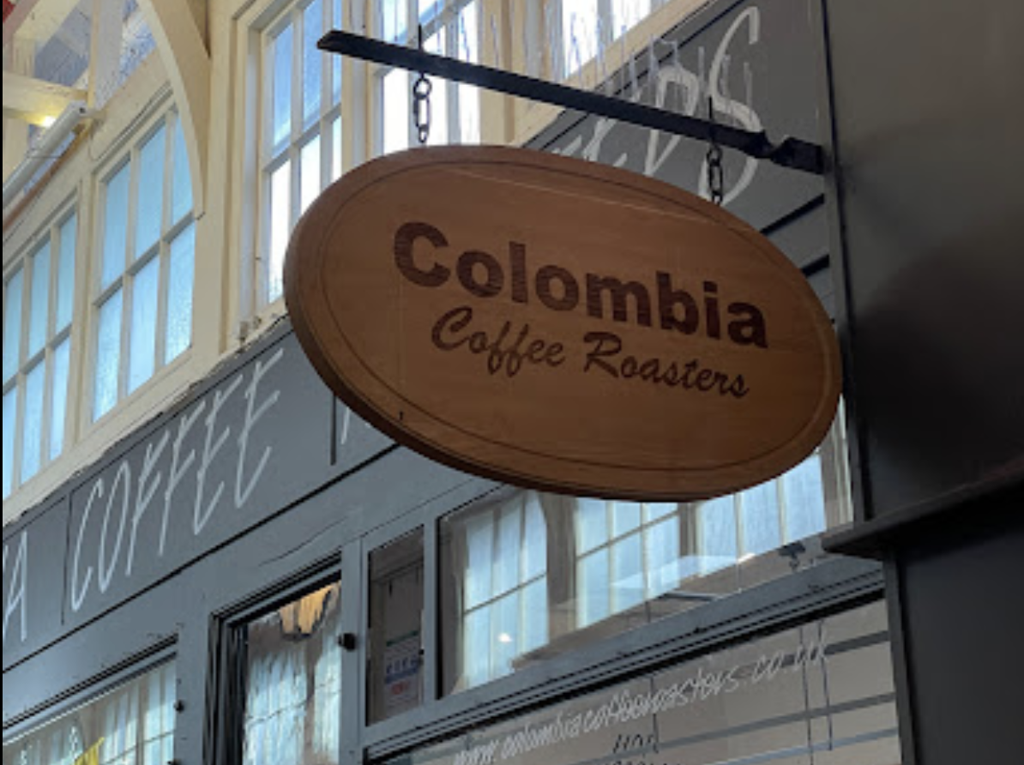
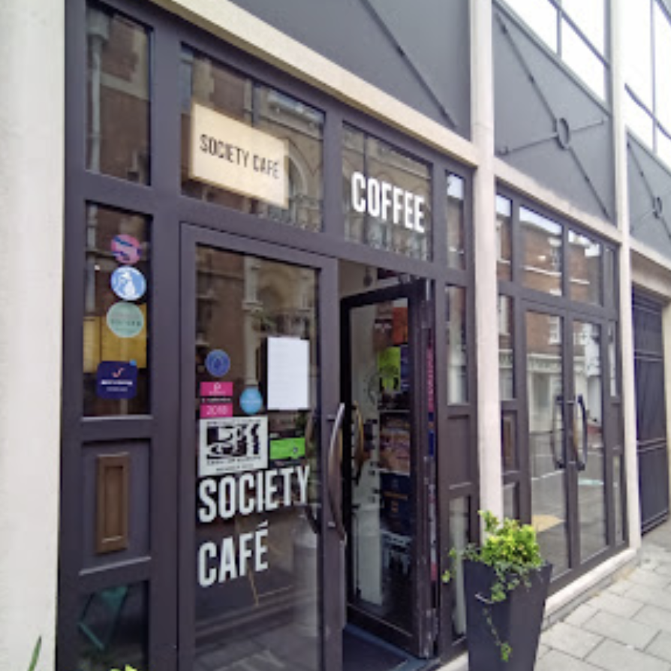
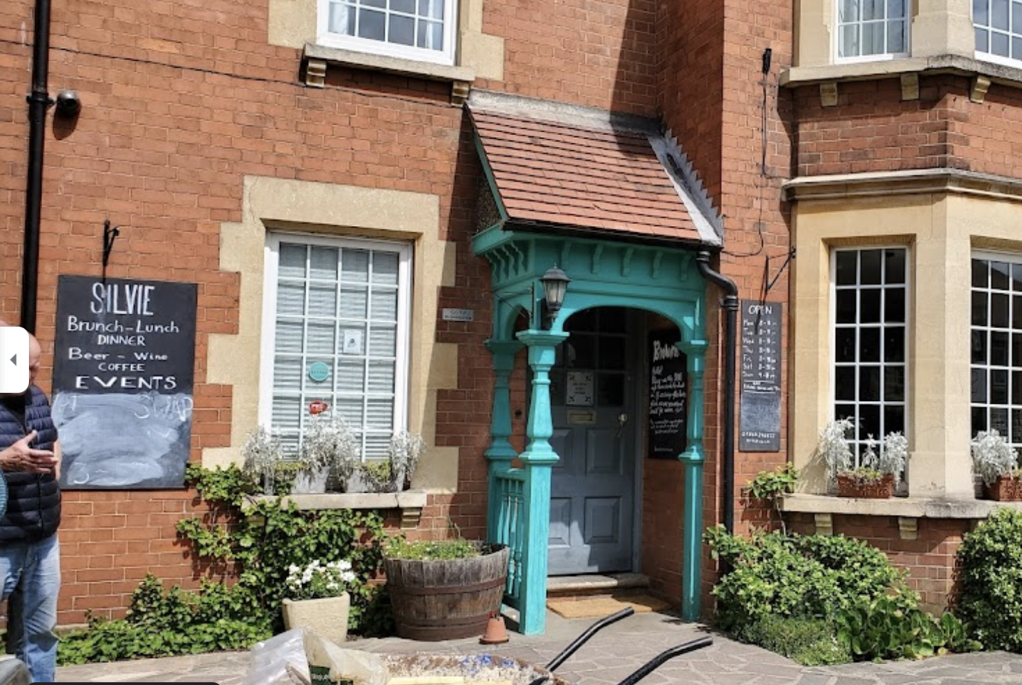
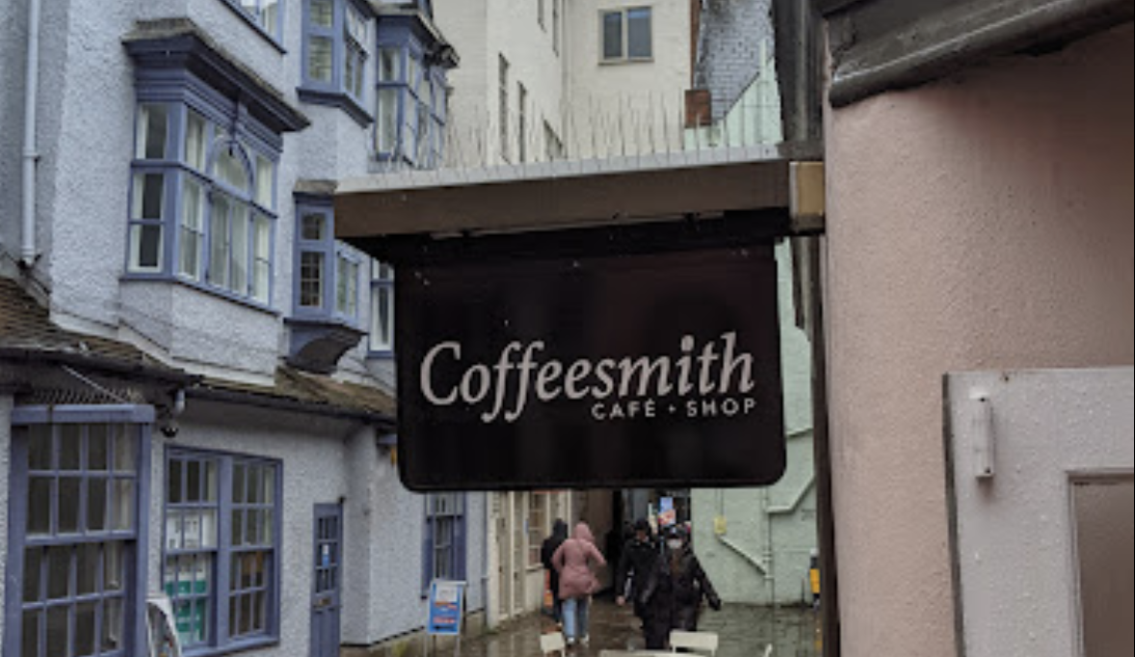
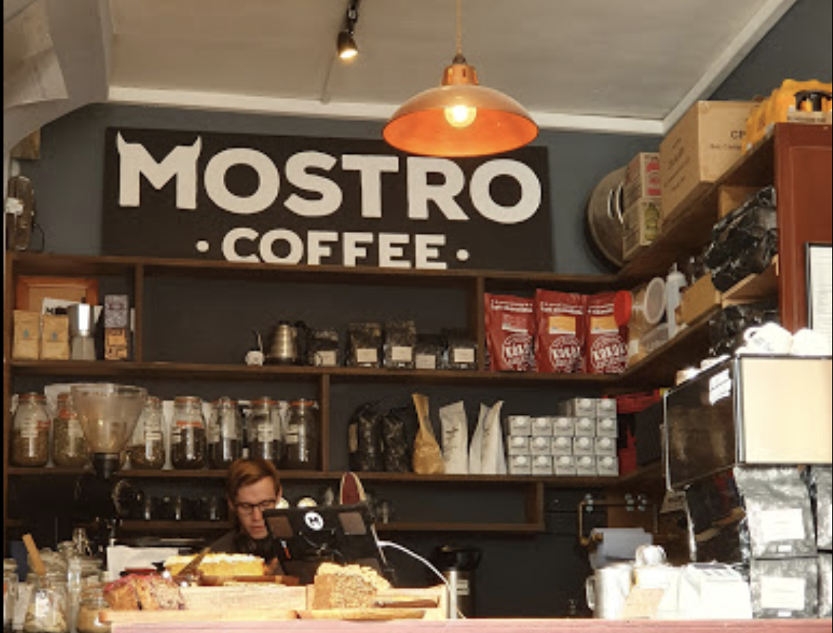
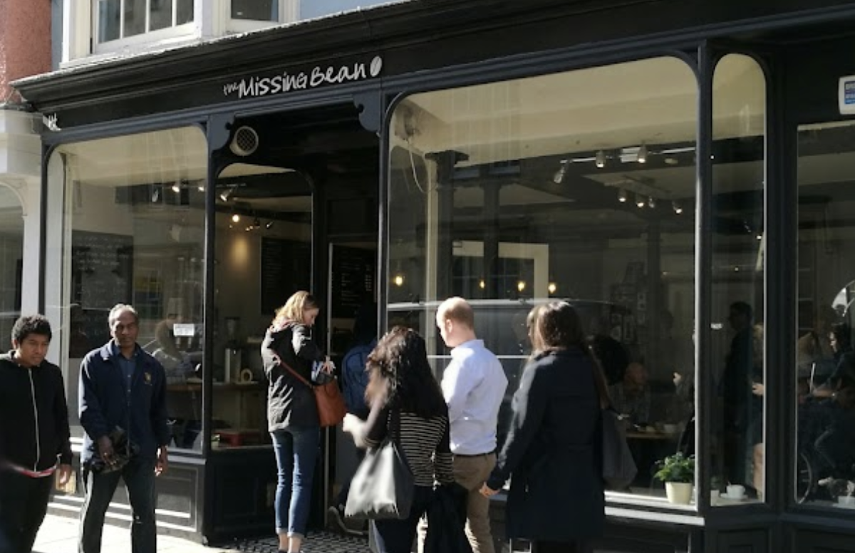
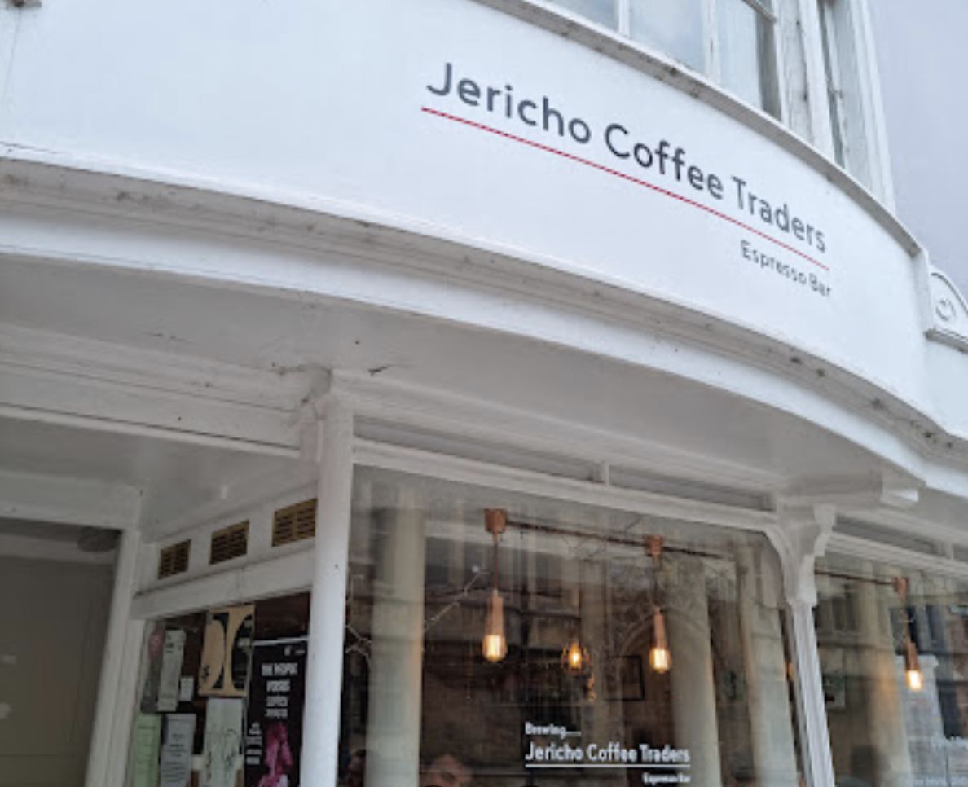
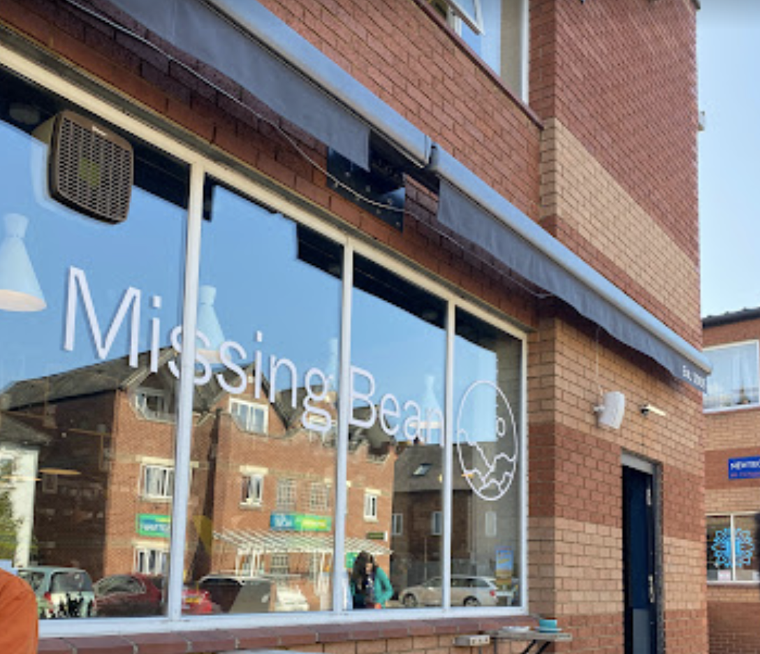
Oxford Independent Coffee
Yi-Chun Wang

Slide 2
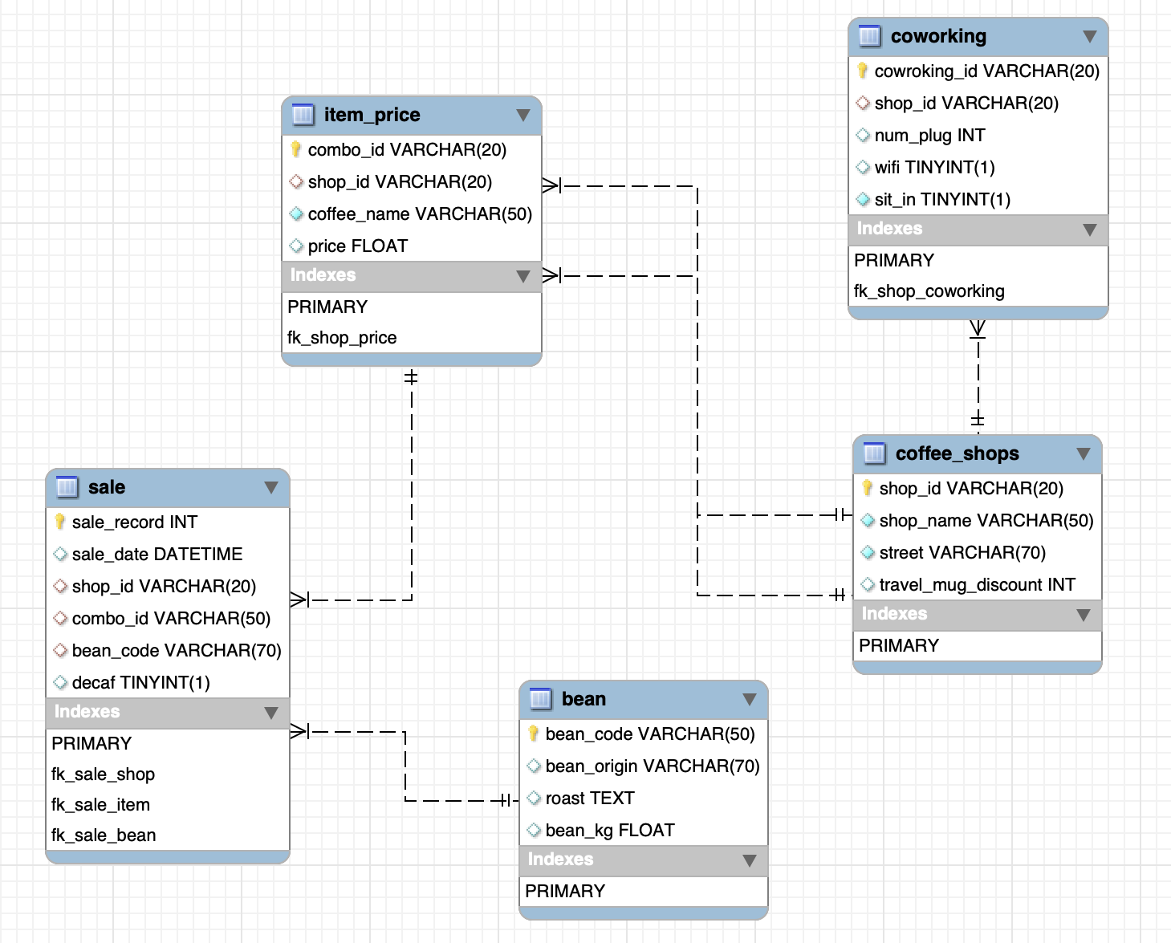
ER diagram

Slide 3
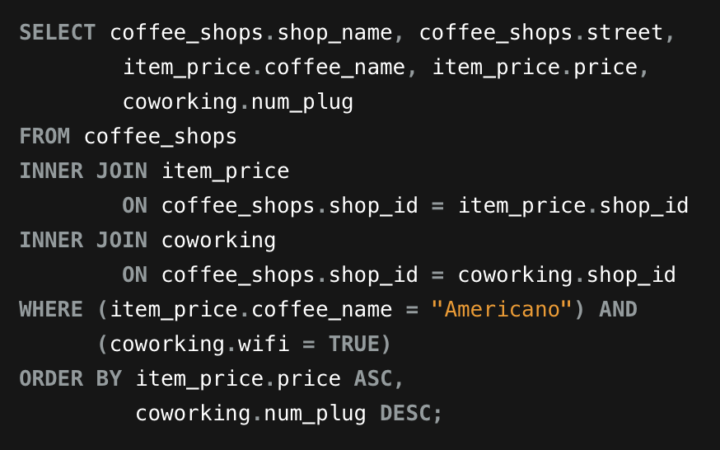
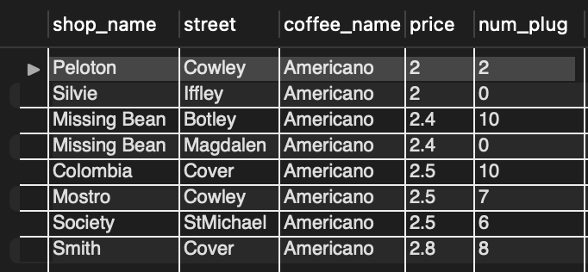
Using any type of the joins create a view that combines multiple tables in a logical way:
Find the oxford cafe that where the Americano is cheapest and provides wifi and plug

Slide 4
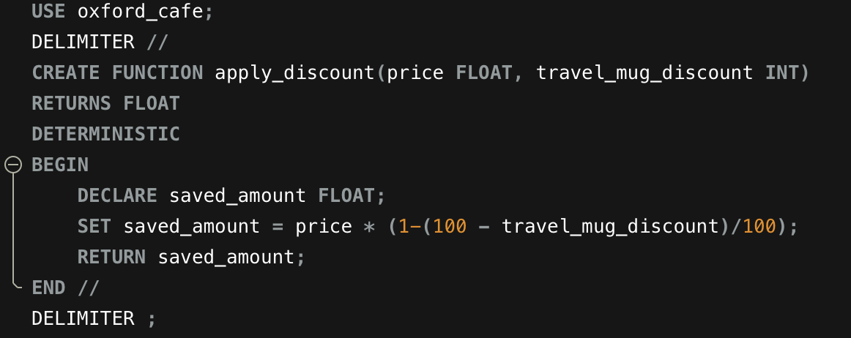
Create a stored function that can be applied to a query in your DB:
A stored function that shows how much one can save if they bring their own travel mug when buying Mocha

Slide 5
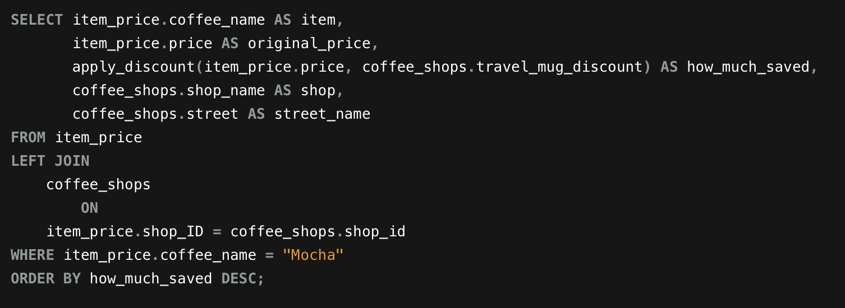
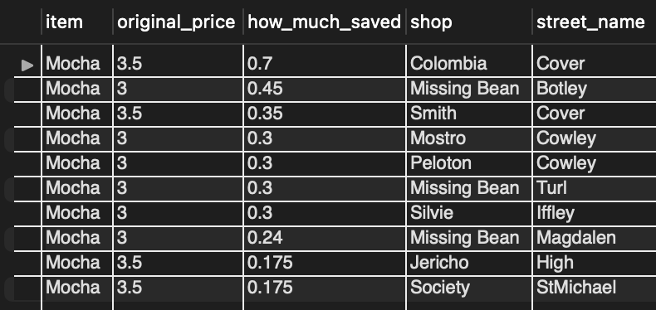
Call the stored function: apply_discount()
shows how much one can save if they bring their own travel mug when buying Mocha

Slide 6
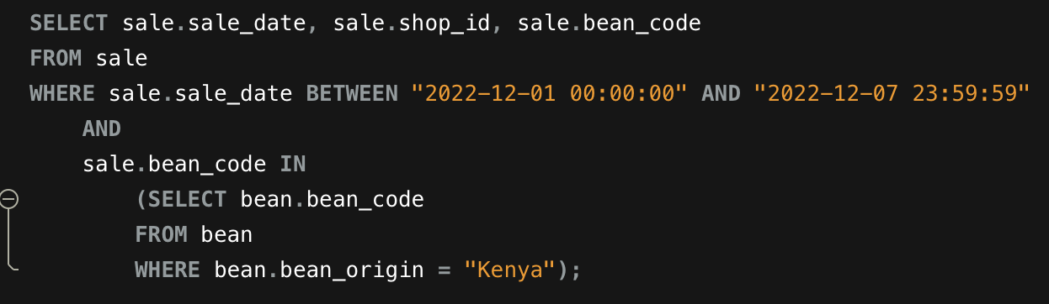
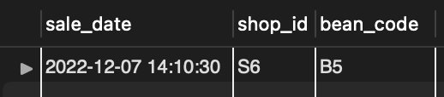
Prepare an example query with a subquery to demonstrate how to extract data from your DB for analysis
Find out in the 1st week of December, where is Kenya's bean being sold

Slide 7
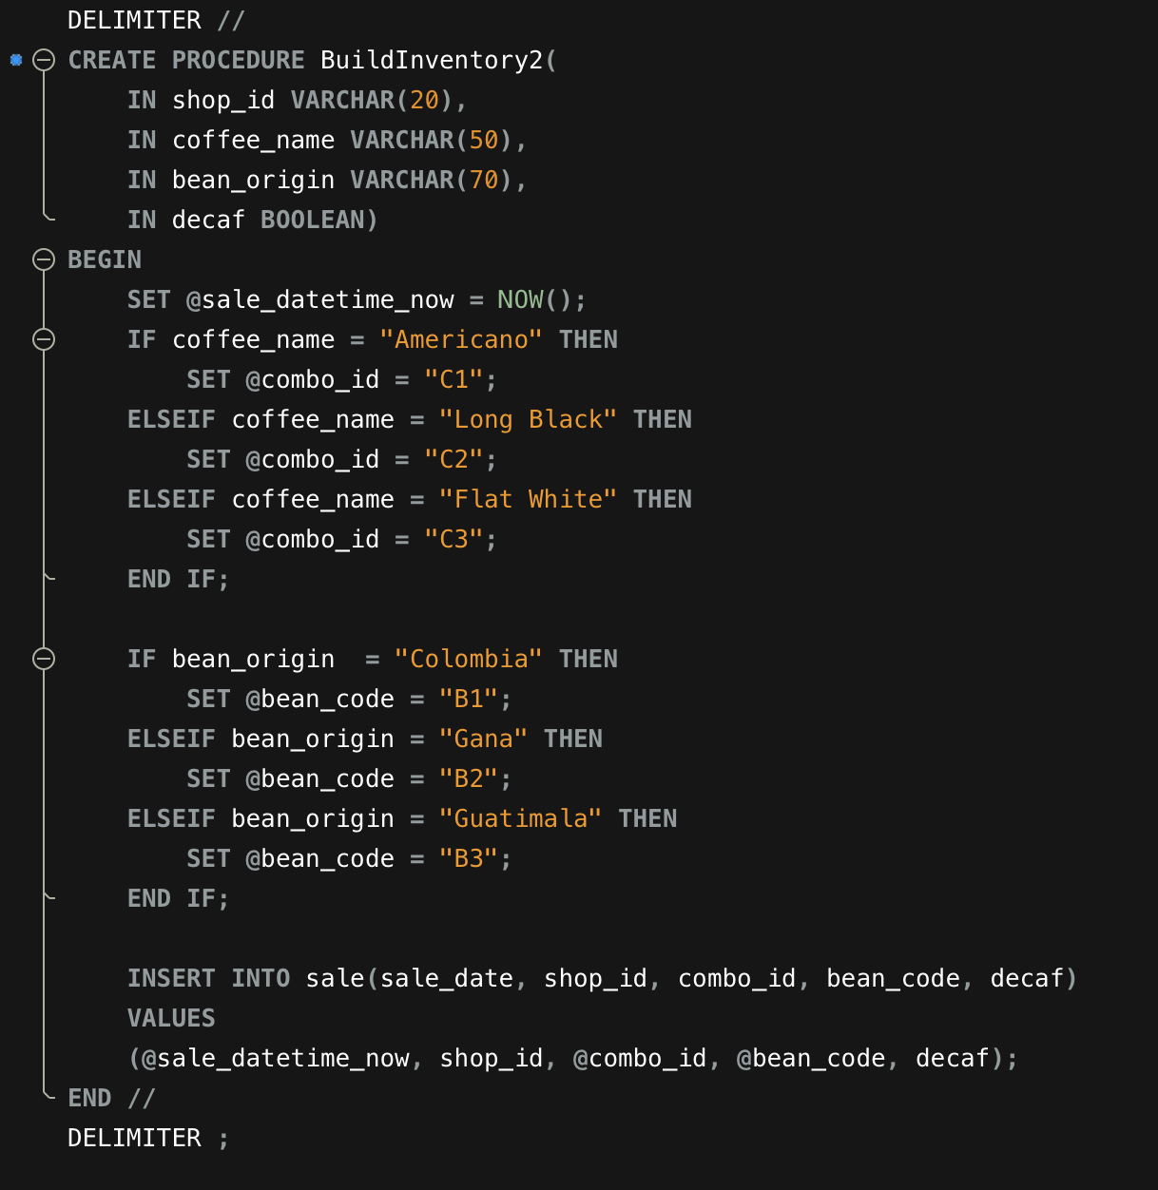
Create a stored procedure and demonstrate how it runs
Aim to speed up adding a new sale:
Automatically increment the sale record each time the procedure is called
Set the DATETIME to now so when they call the procedure, the time would have been set,
Staff only need to give shop_id, coffee_name, bean_origin, decaf or not, they don’t need to remember to combination of shop and coffee_id, and which bean_id the bean origin is associated

Slide 8
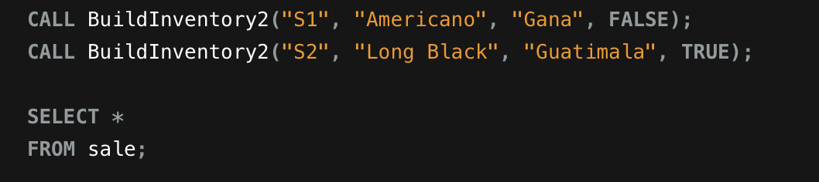
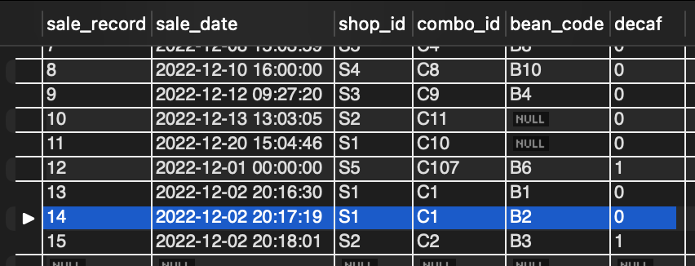
Call the stored procedure: BuildInventory2()

Slide 9
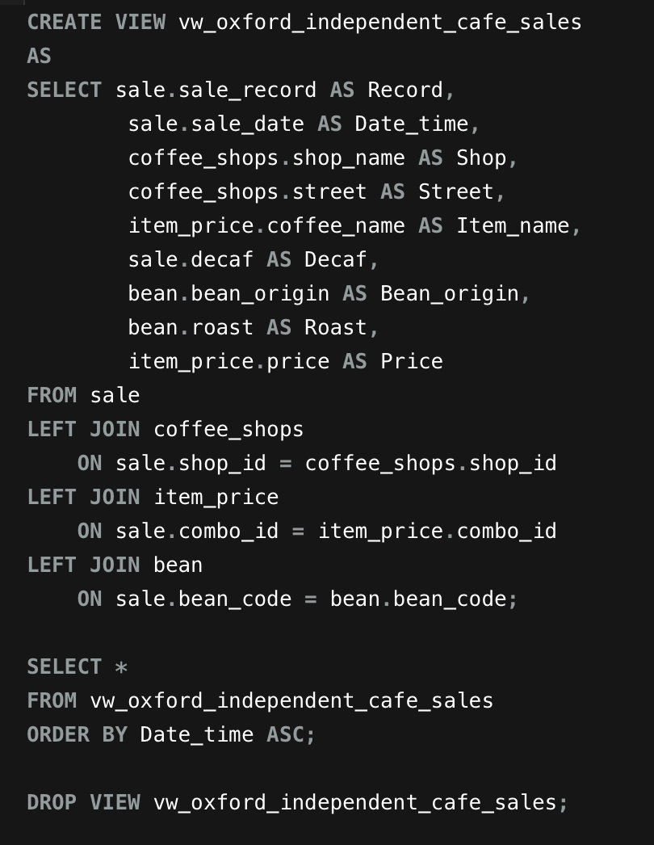
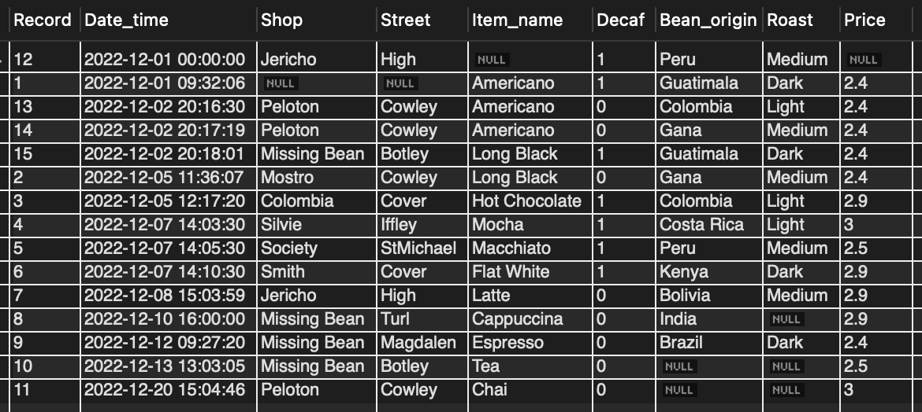
Create a view that uses at least 3-4 base tables
demonstrate a query that uses the view to produce a logically arranged result set for analysis.
A view that combine the sale_record with relevant information from the tables: coffee_shops, item_price, bean

Slide 10
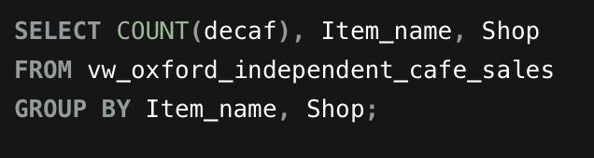
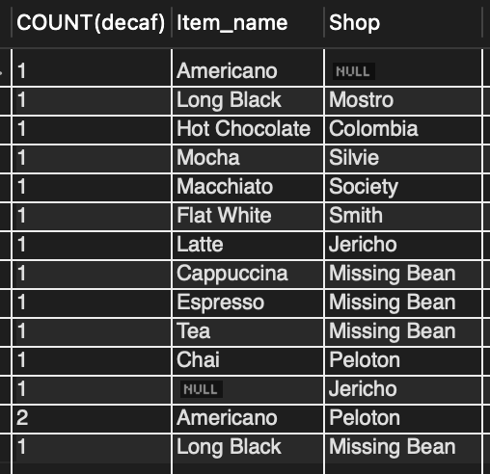
Prepare an example query with group by
count how many decaf coffee had been sold by which shop

Slide 11
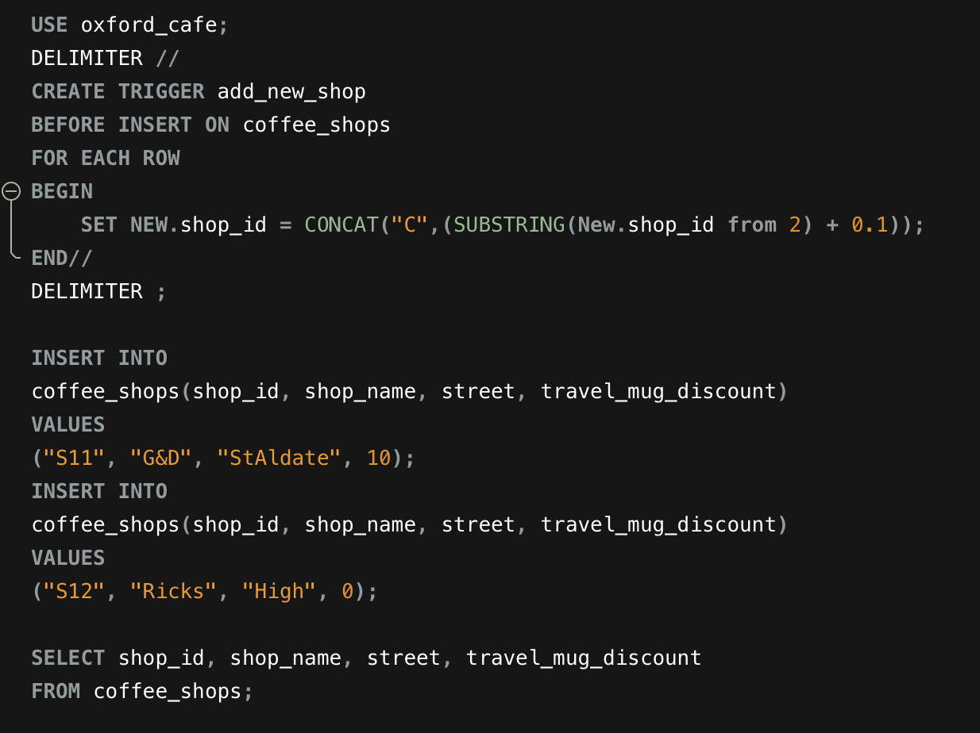
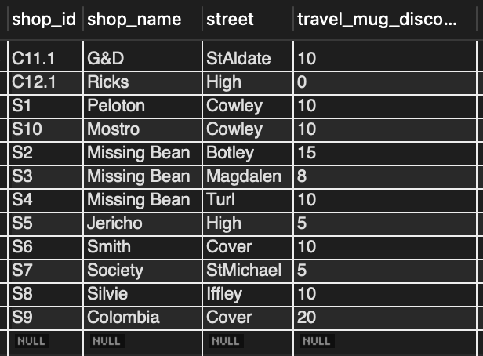
Create a trigger and demonstrate how it runs
When there is a new coffee shop, add them with their shop_id in 0.1 increment

Slide 12
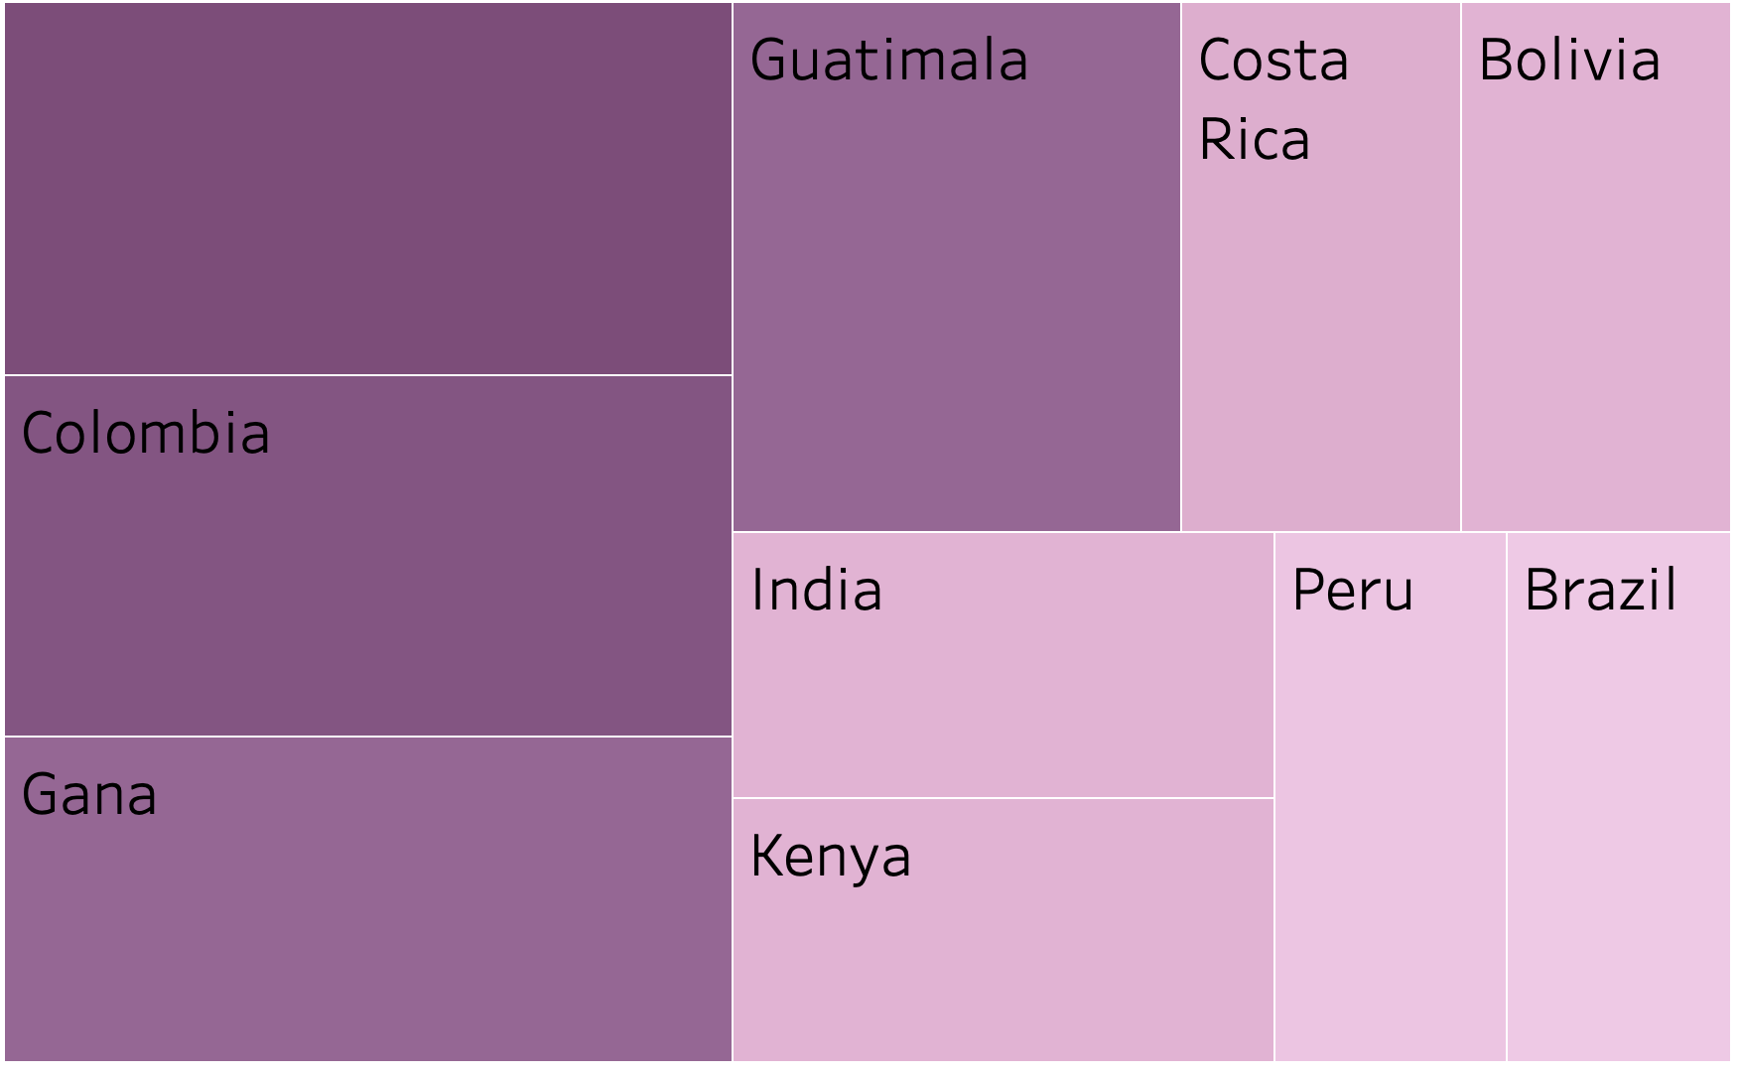
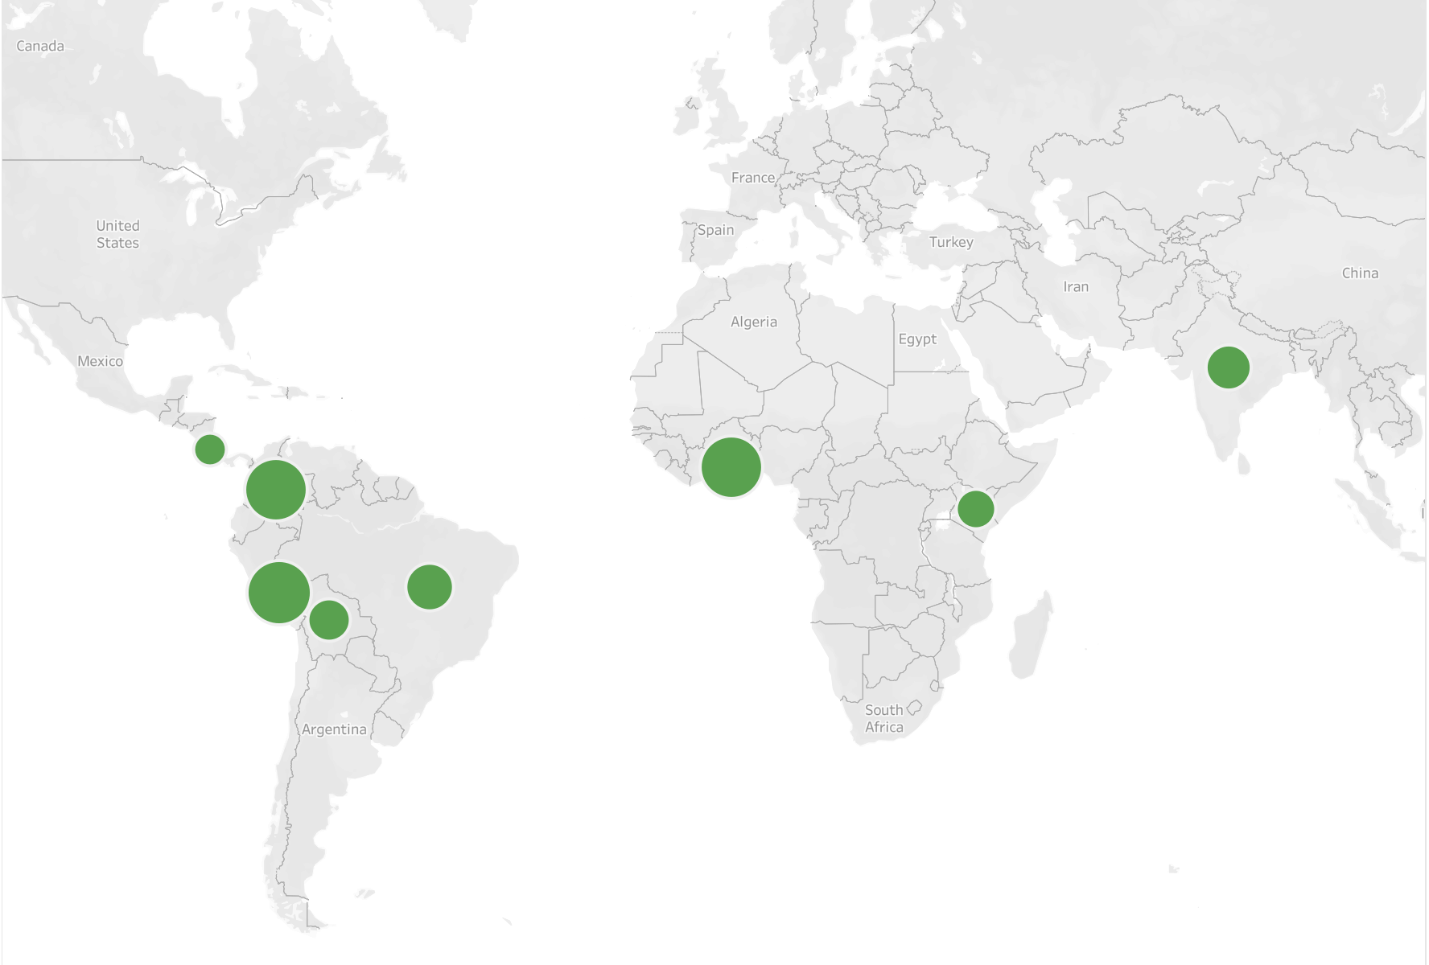
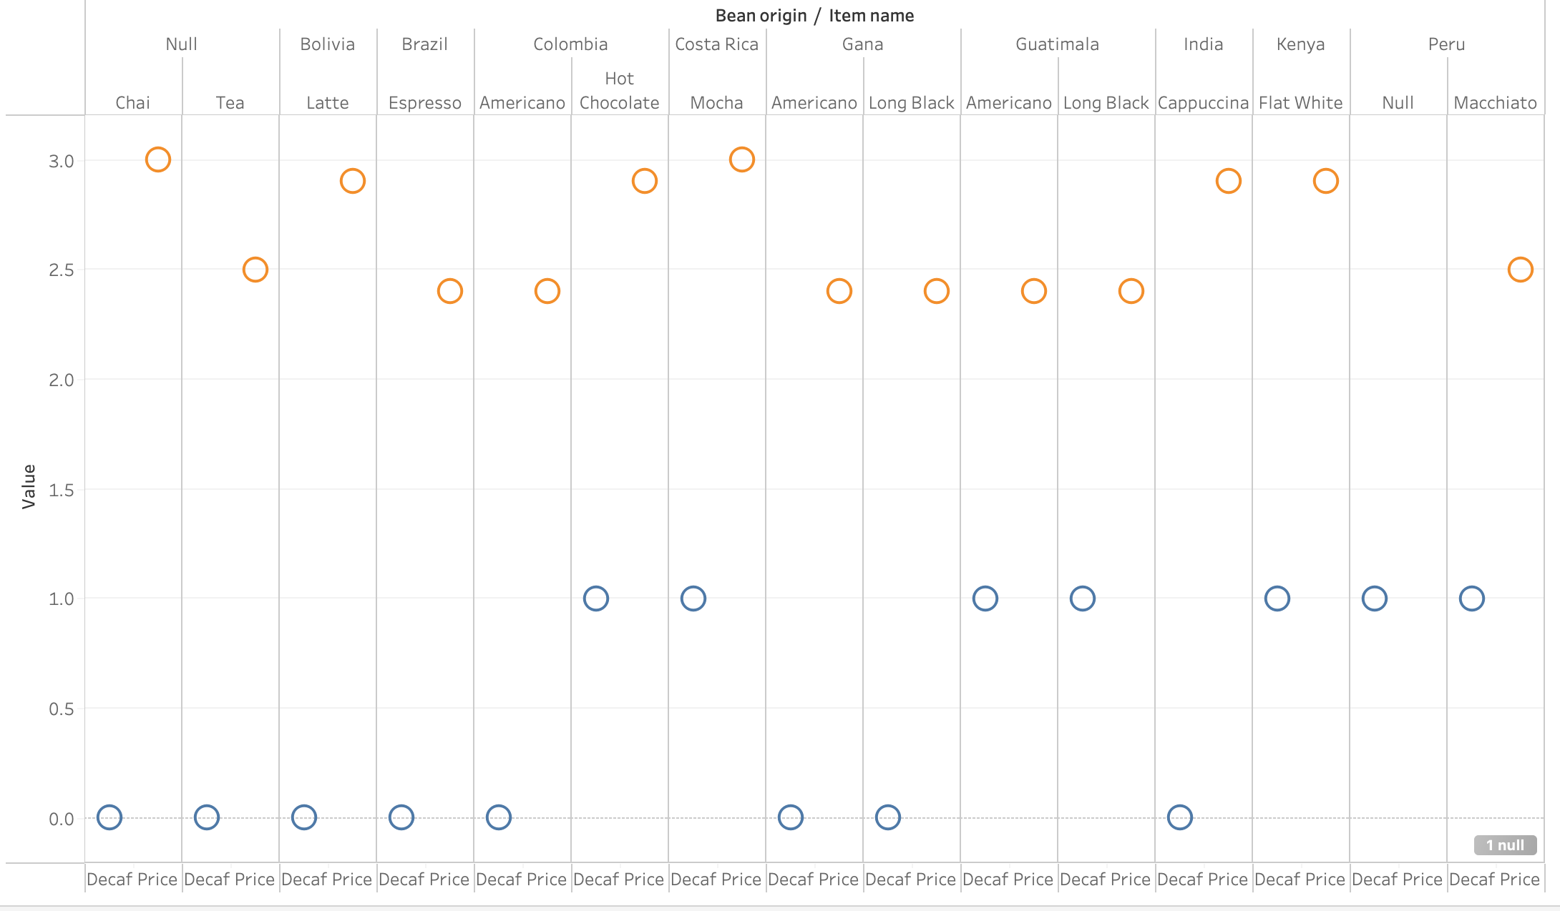
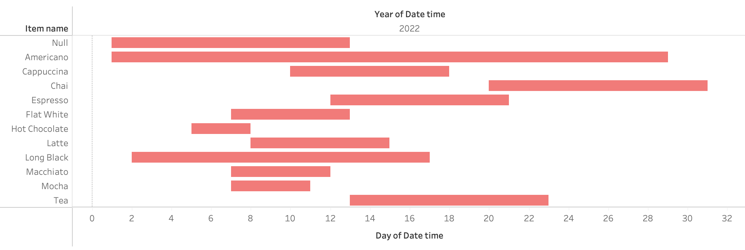
Tableau Visualisation

Slide 13




Thank you
GitHub: https://github.com/WhySeeYC

